Slide 1


TastyTalks
An Engaging Social Platform Designed for Food Enthusiasts, Chefs, and Interactive Recipe Communities

Slide 2

Accuracy of Results
TastyTalks ensures content integrity through a layered validation framework that minimizes misinformation and duplicate recipes.
Role-Based Validation
User Ratings & Feedback
Chefs and verified contributors are granted elevated permissions to publish and moderate recipe content, ensuring authoritative accuracy.
Community-driven star ratings and structured review mechanisms flag low-quality or incorrect submissions for moderator review.
Content Moderation
Automated duplication checks and admin moderation workflows reduce redundant posts and maintain a high-quality recipe repository.

Slide 3


Technical Competence
TECH STACK
Core Technologies
Frontend: React.js
Responsive, component-driven UI with seamless state management
Backend: Spring Boot
RESTful API design, JWT authentication, and role-based access control
Database: MySQL
Relational schema supporting scalable user, recipe, and interaction data

Slide 4
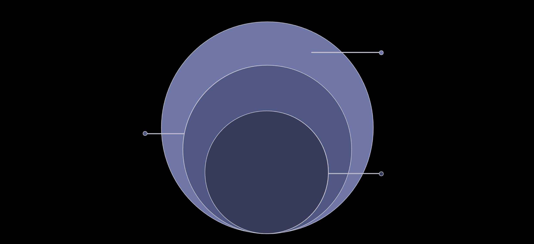
System Architecture Overview
API Gateway
Spring Boot REST handling requests and routing
Business Logic
Authentication, roles, moderation, and rules enforcement
Core Database
MySQL persistent storage for entities and relations
The platform follows a clean separation of concerns across four layers — ensuring maintainability, scalability, and secure role-based interactions from the client to persistent storage.

Slide 5

Innovative & Sustainable Features
Social + Recipe Integration
Uniquely merges social networking with structured recipe sharing — bridging the gap between casual food lovers and professional chefs.
Chef Recognition
Verified chef profiles with credibility badges foster professional visibility and encourage high-quality content contributions.
Future: AI Integration
Planned features include AI-powered recipe recommendations, ingredient substitution suggestions, and personalized meal planning.

Slide 6
Utility to Society
Who Benefits?
TastyTalks serves a broad and diverse audience, creating measurable value across multiple user groups:
Home Cooks & Beginners
Professional Chefs
Food Communities
Build a following, share expertise, and gain recognition.
Engage in collaborative cooking culture and knowledge exchange.
Access structured, validated recipes with community guidance.

Slide 7
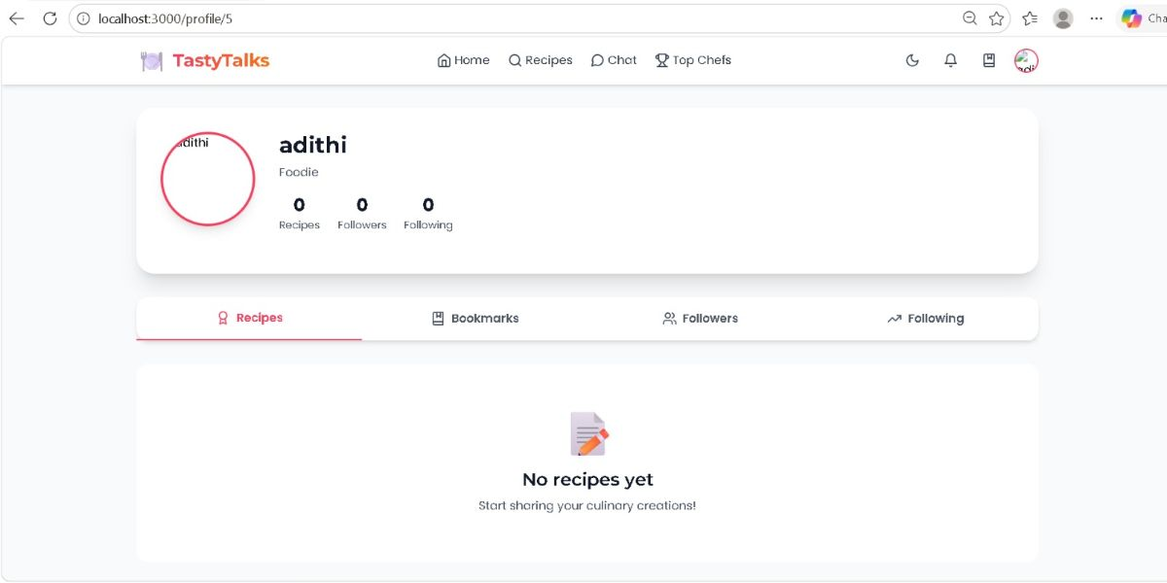
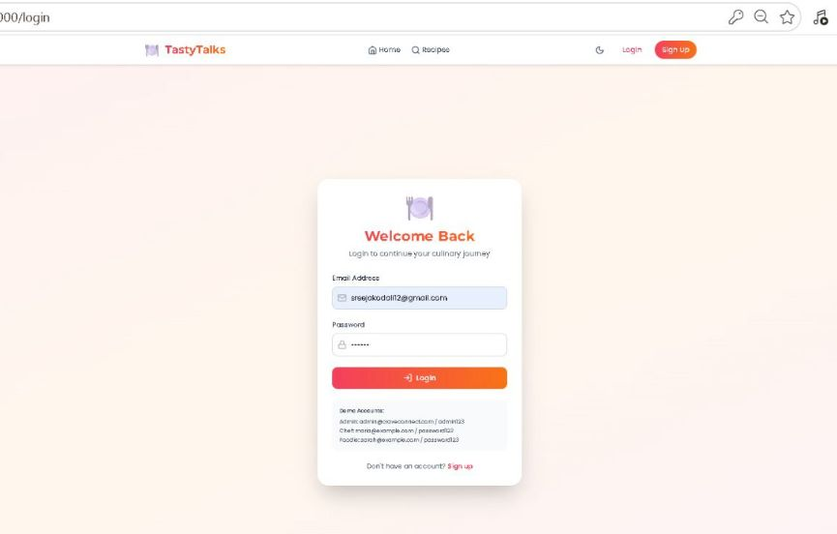
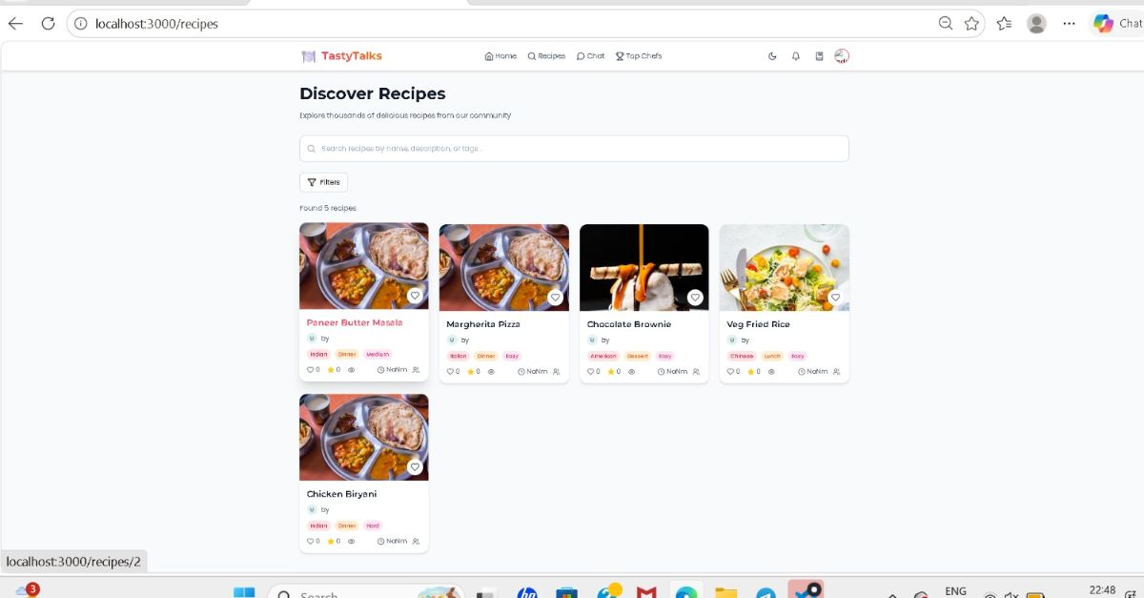
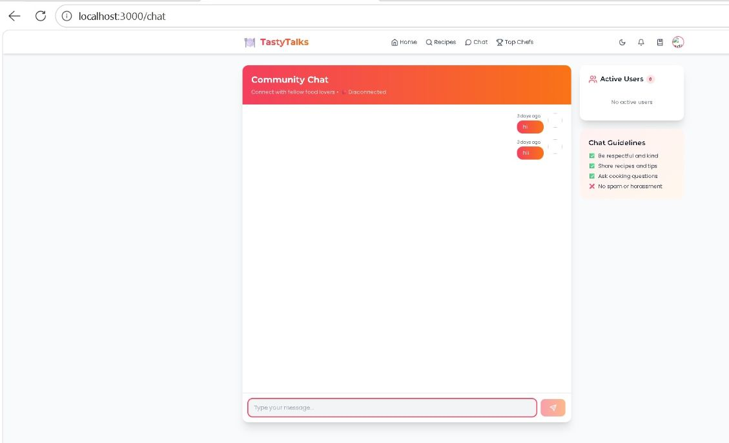

Slide 8
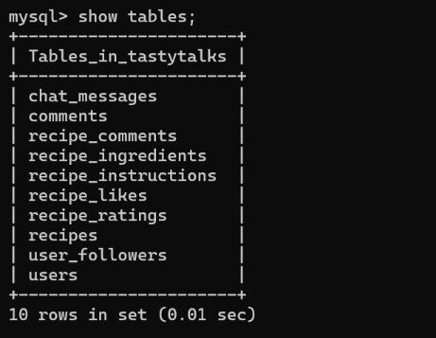
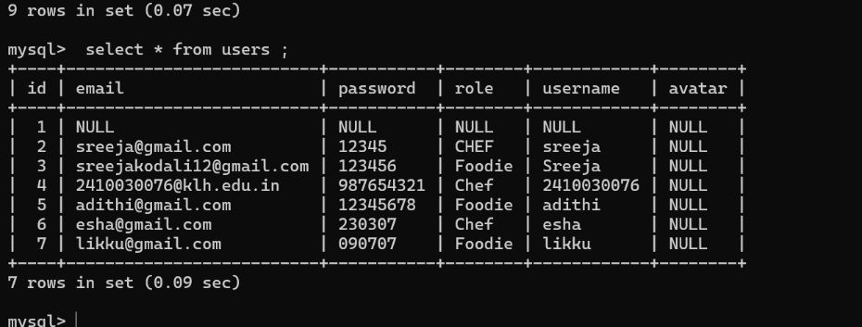
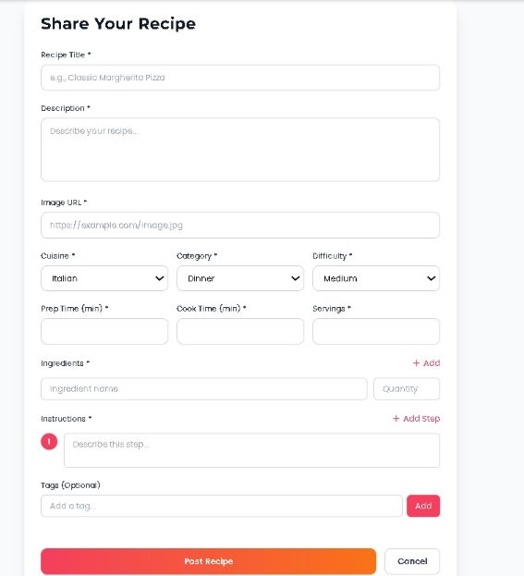
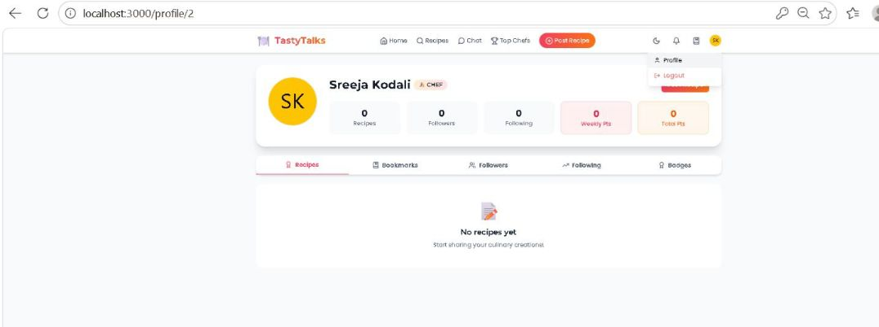

Slide 9
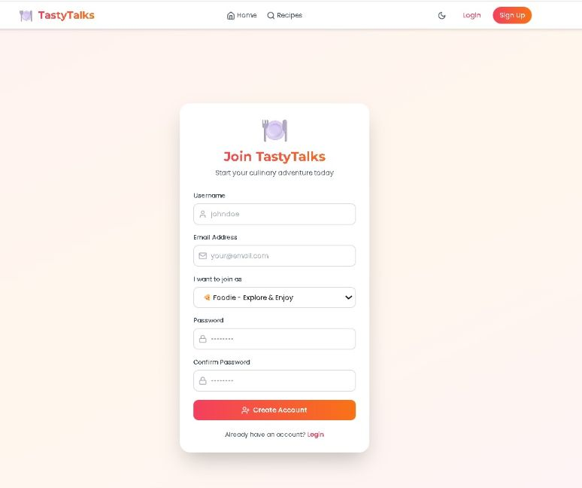
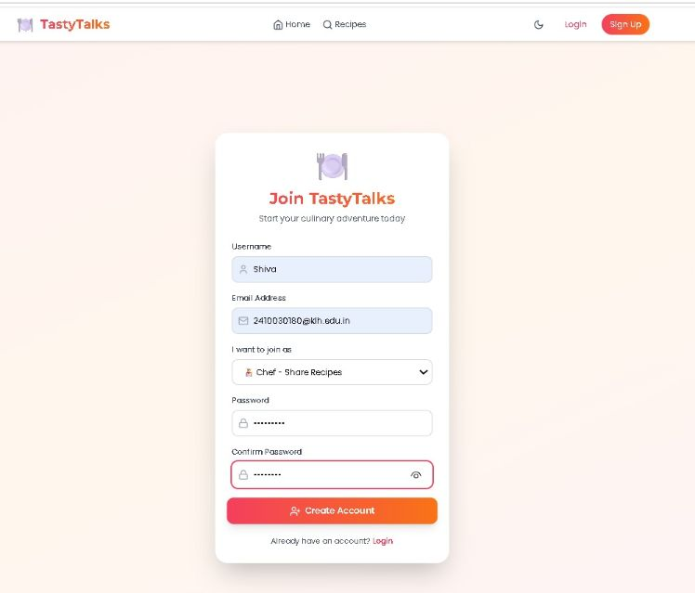

Slide 10
Conclusion
TastyTalks demonstrates a technically robust, socially impactful, and academically rigorous solution to modern recipe-sharing challenges.
System Effectiveness
Technical Strength
Validated content pipeline and moderation ensure reliable, high-quality recipe data at scale.
React, Spring Boot, and MySQL deliver a secure, performant, and maintainable full-stack architecture.
Real-World Applicability
With planned AI features and a scalable design, TastyTalks is positioned for meaningful, long-term societal impact.

Slide 11
THANK YOU
2410030076 – KODALI NAGA SREEJA
2410030180 – ANUGU SHIVA KUMAR REDDY
2410030228 – BIJJU ADITHI YADAV
2410030229 – LIKITHA THUMMA
2410030232 – H. ESHA MANOGNA

